Slide 1

When inspired minds come together, miracles happen.

Slide 2
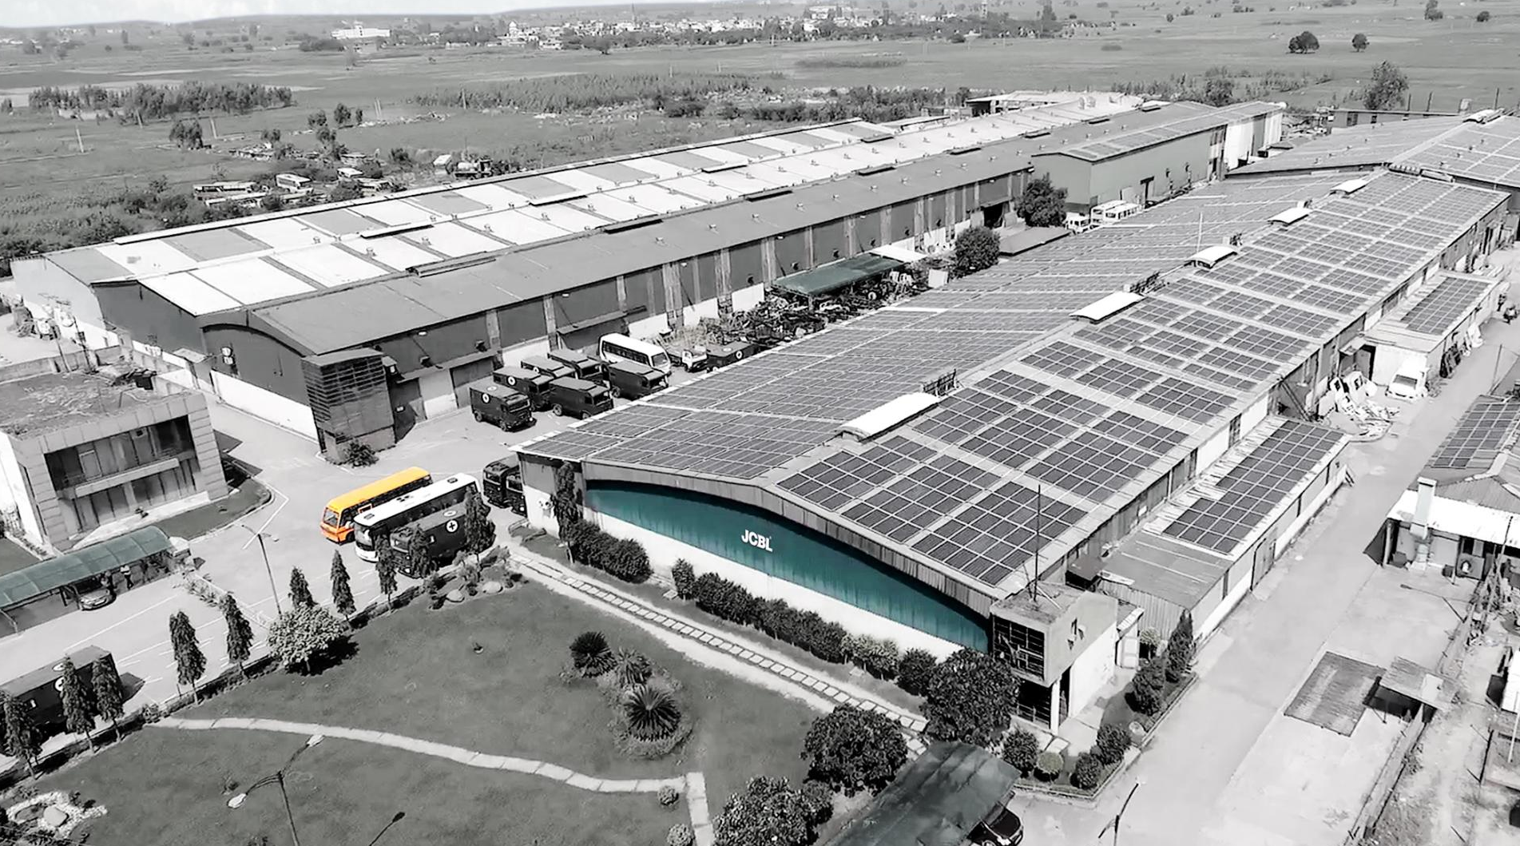
JCBL GROUP
The JCBL Group stands as a beacon of passion and inspiration. Established in 1989, we have transformed a bold vision into a dynamic reality, positively impacting the lives of over a billion individuals worldwide.
From initial foray into mobility solutions, today the Group has established a strong presence across key sectors of the economy, including Mobility Applications, Defence and Aerospace, Parts and Components for Railways, Buses and Industries, Agriculture and Measurement and Control Instruments.
35+ years
5 Manufacturing Facilities
216.87 million USD
20% CAGR
500+ Clients
30+ Countries
2.76 Million Square Feet Manufacturing Area
2000+ Trained Professionals

Slide 3





DIVERSE MANUFACTURING INTERESTS
Measurement & Control Instruments
Mobility Applications
Passenger Transportation
Special Application Vehicles
Healthcare
Logistics
Mining and Construction
Valves
Compression Tube Fittings
Custom Built Parts
Manifolds
Parts & Components For Railways, Buses & Industries
Agricultural Implements
FRP/GRP
Sheet Metal/Heavy Machinery/General Fabrication
Seats
Window Frames and Components
Land Preparation
Seedbed Preparation
Crop Residue Management
Defence & Aerospace Solutions
Aerospace
Maintenance Repair & Overhaul
Combat System
Land System

Slide 4
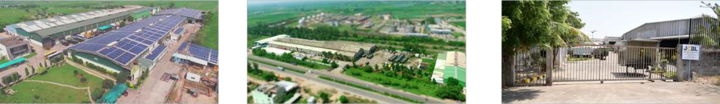
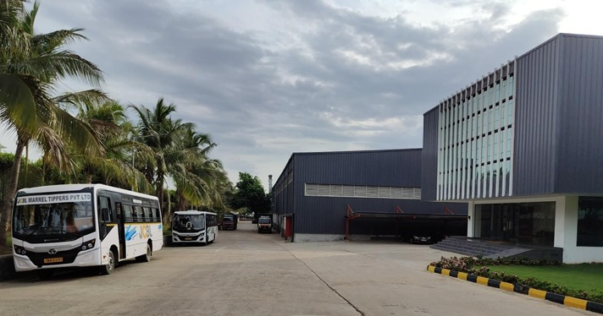
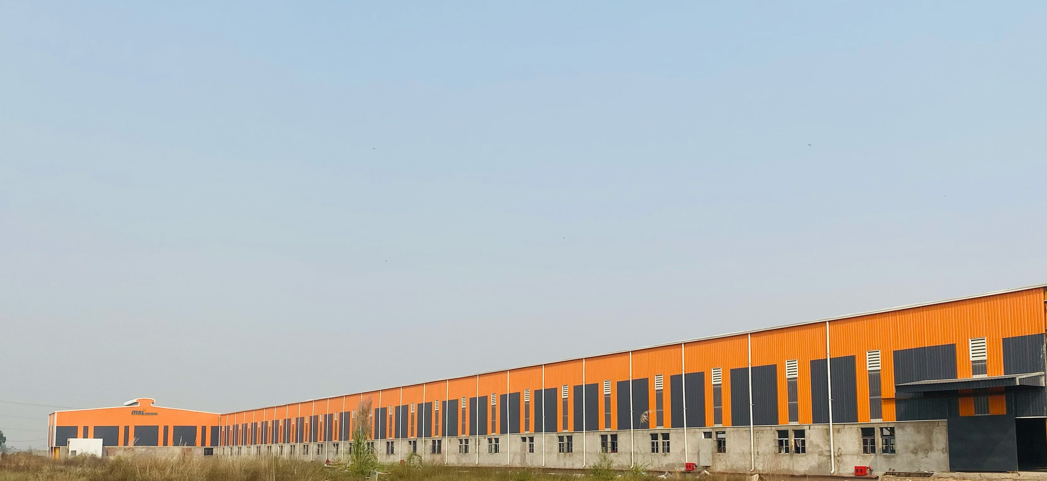
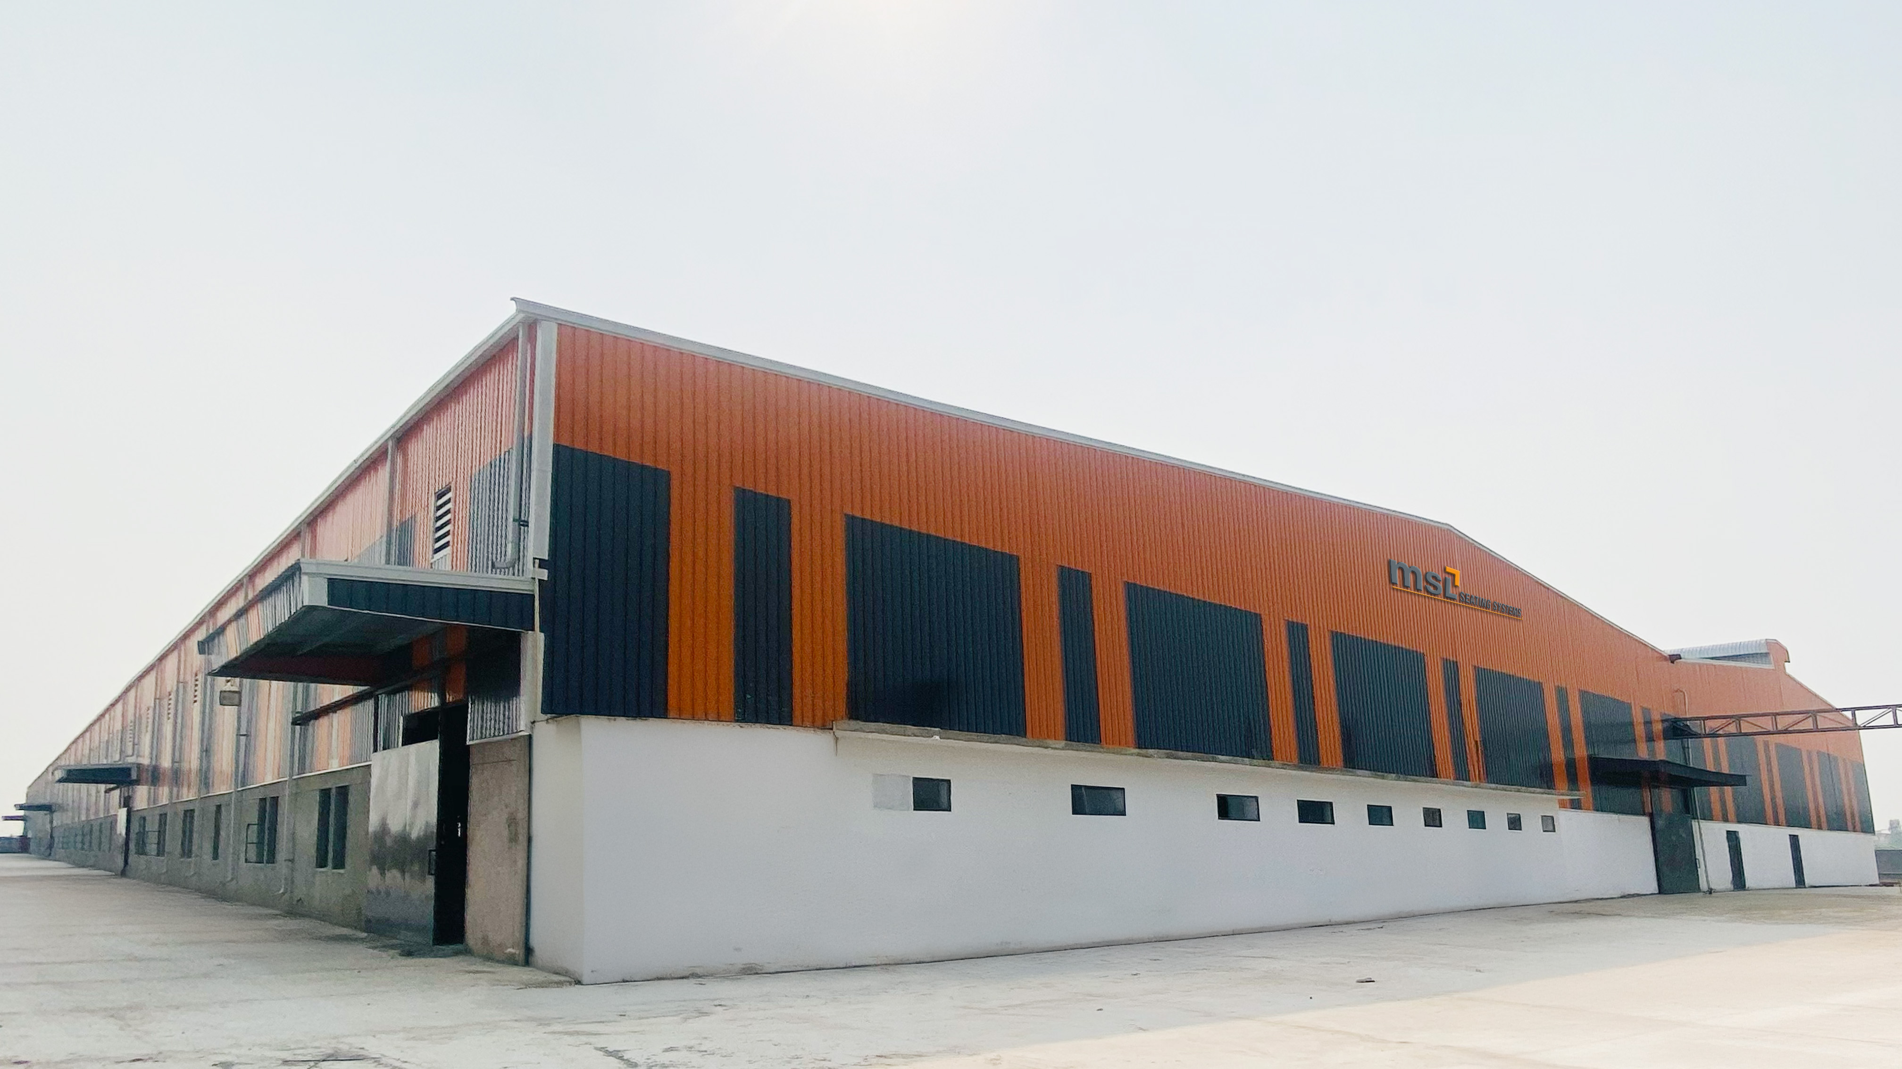
INFRASTRUCTURE
We boast of our manufacturing excellence through our modern and well integrated plants located in northern and southern parts of the country. We use the latest cutting‐edge technology and machines.
At every stage of the product evolution‐design, construction, manufacturing, and assembly, quality checks are carried out meticulously by monitoring performance, efficiency, and, above all, safety.
JCBL
ADSL
MSL TechnoFab
MSL Composites
MSL Seating Systems

Slide 5






TECHNOLOGY PARTNERS
JCBL stays ahead of the curve through continuous investment in research and development, cutting-edge technology and strategic collaborations with global market leaders, design houses, and engineering firms. Our strength lies in bringing together diverse, multidisciplinary teams that work in real time to tackle complex engineering challenges and deliver world-class tailor made solutions.
Sources of our Technologies:
Interior Systems – ELLAMP Systems, Italy
Composites – Stratiforme Industries, France
Seats – APM, Malaysia
Locks and Components
HAPPICH, Germany
Remote Controlled Weapon System
ROLUS, Slovakia
Loitering Munitions
Lemontronix GmBH, Germany

Slide 6






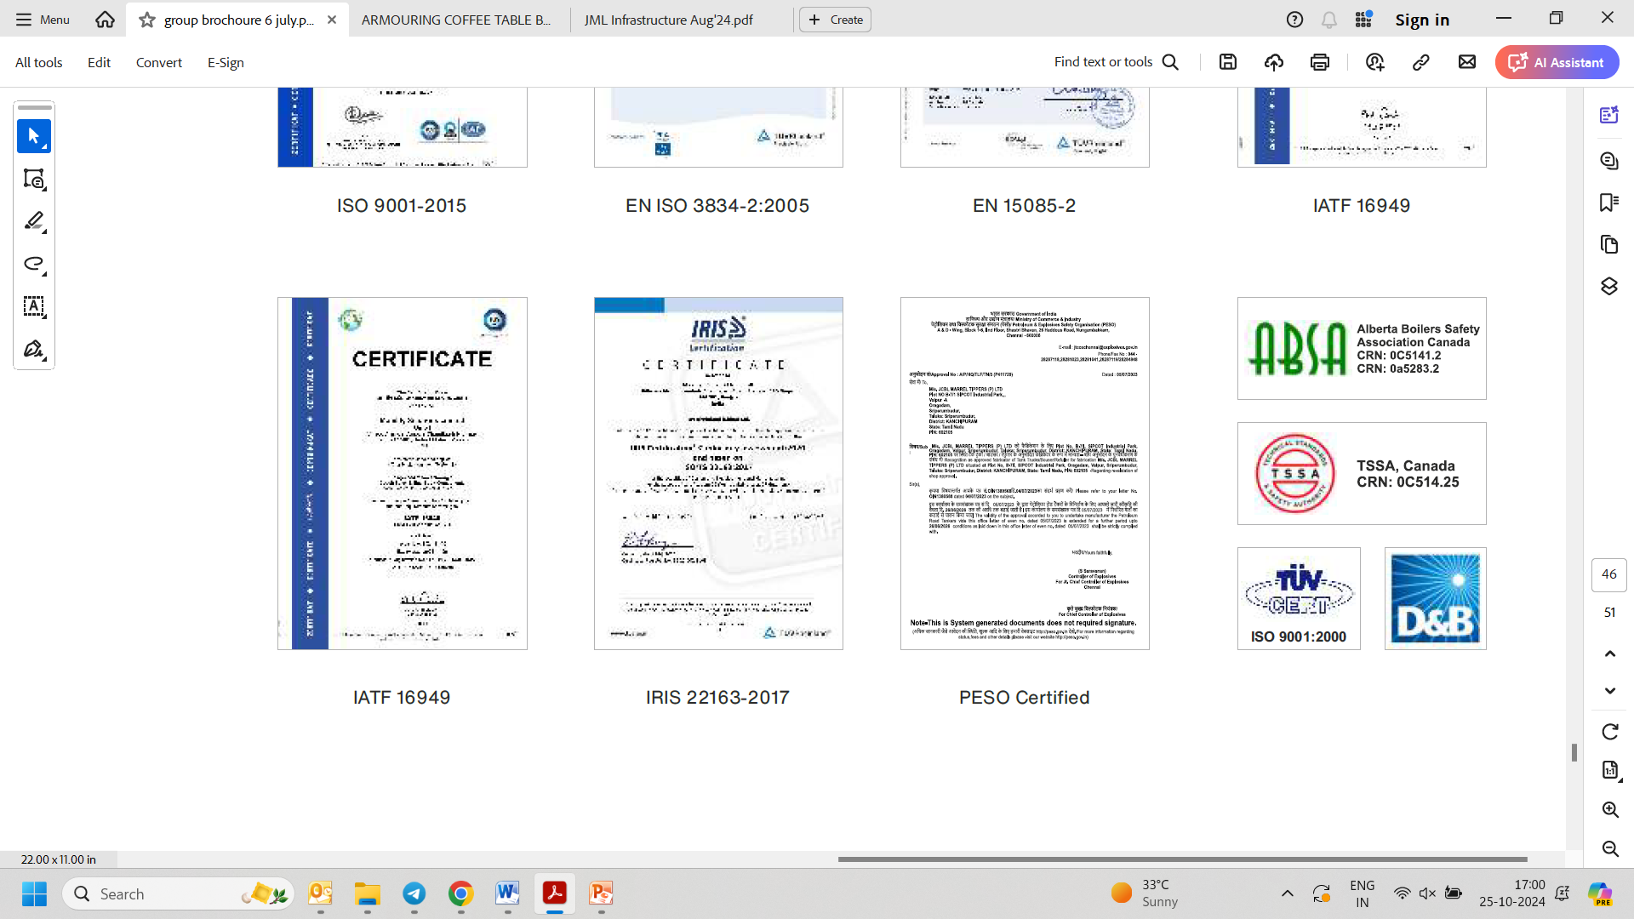





QUALITY CONTROL SYSTEM
Our Quality Policy
We always remain committed towards total satisfaction of our Customers, Associates and Society at large through continual improvement in Quality Management System and the collective effort of all our employees.
IATF 16949
ISO 9001꞉2015
CMMI Level 3
ISO/IEC 27001꞉2013
EN ISO 3834‐2꞉2005
EN 15085‐2
AS 9100
Registered with
Ministry of Defence–DGQA
IRIS 22163‐2017
PESO Certified
LRQA Certified- International
Convention for Safe Container

Slide 7


Striving for a safer future

Slide 8
COMPANY BRIEF
For over 35 years, JCBL Group a trusted name in the industry, providing cutting‐edge defence solutions across various applications.
Driven by our mission to design, manufacture, service, and upgrade strategic and tactical defence equipment, armoured vehicles, and aerospace technologies, we established Airbornics Defence & Space Private Limited. Today, ADSL is a leading force in Defence and Aerospace, specializing in the design, manufacturing, servicing, and upgrade of Aerospace systems, strategic Defence platforms, and Armoured Vehicles. Committed to the highest industry standards, ADSL is certified with ISO 9001:2015, IATF 16949:2016, ISO/IEC 27001:2013, CMMI Level 3, and AS 9100D for Aerospace QMS, ensuring excellence in every domain. Our mission is to deliver next-generation solutions that enhance precision, resilience and operational superiority for the Armed Forces.
At ADSL, we are not just manufacturing defence and aerospace solutions—we are engineering the future of security and aerospace.

Slide 9
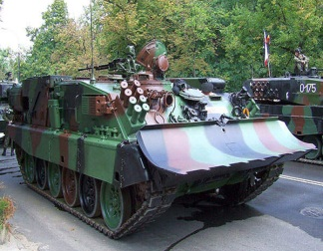
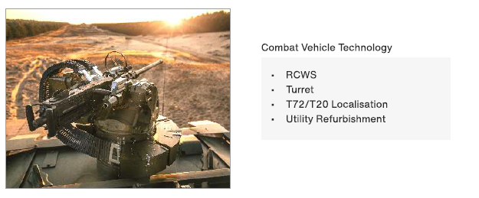
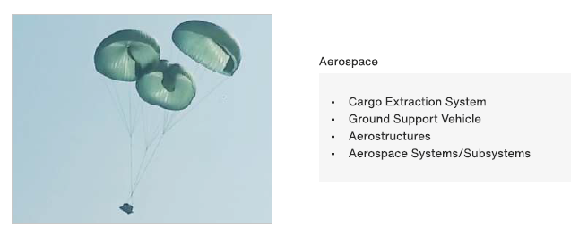
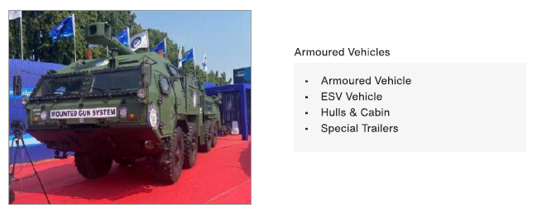
NEXT GEN SOLUTIONS
Maintenance Repair & Overhaul
Modernization & Localisation of ARVs:
T72
T90
WZT3
T55
BMP
Combat System
RCWS
Turret
Active Protection System
Anti Drone System
Border Surveillance and Perimeter Protection
Aerospace
Cargo Extraction System
Ground Support Vehicle
Aerostructure
Aerospace Systems/Subsystems
Land System
Hulls & Cabin
Trailers & Shelters
Special Trailers
Armoured Vehicle

Slide 10
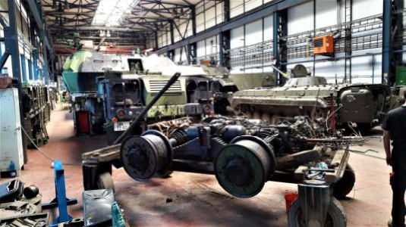
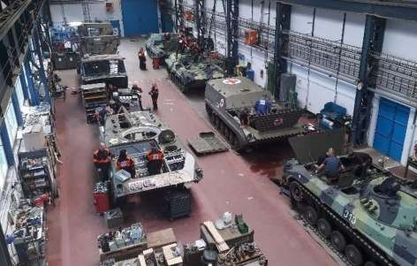
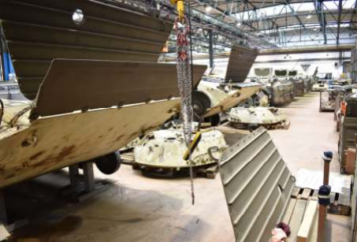
Overhaul, Modernization and Spare Parts of Military Vehicles
Ours and Our Partner Specialization:
Main battle tanks: T-55, T-72
IFVs and their modifications: BMP-I, BMP-II / IIK, PRAM
Self-propelled mortar, recovery BMP etc.
Artillery systems: RM-70, 152 mm
DANA
Vehicles on TATARA chassis
Repairs of individual spare parts, refurbishment and overhaul of engine and transmission.
Our Partners Advantages:
Modern facilities with all equipment to conduct complex maintenance, overhaul, and modernization services for both wheeled and tracked vehicles as well as special vehicles for military engineers.
Experienced personnel who undergo regular training to ensure top quality services to our customers.
25 years of experience.
152 mm DANA Howitzer Repairs
Repairs of Tracked Vehicles
Repairs of BMP-II / IIK

Slide 11
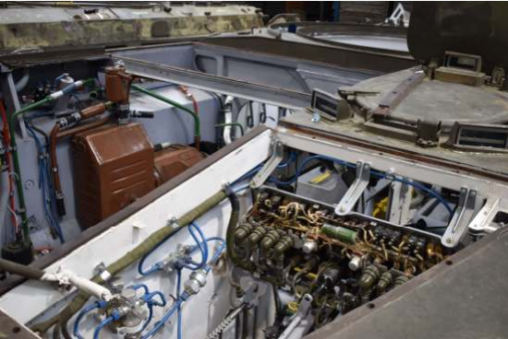
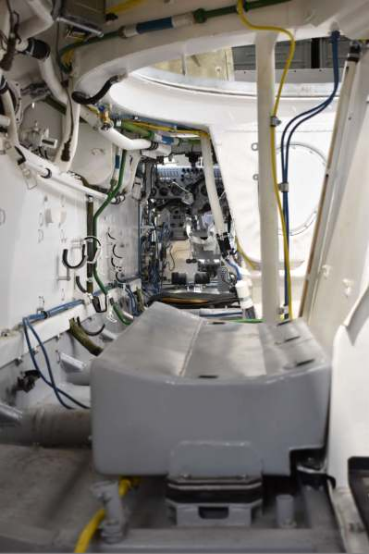
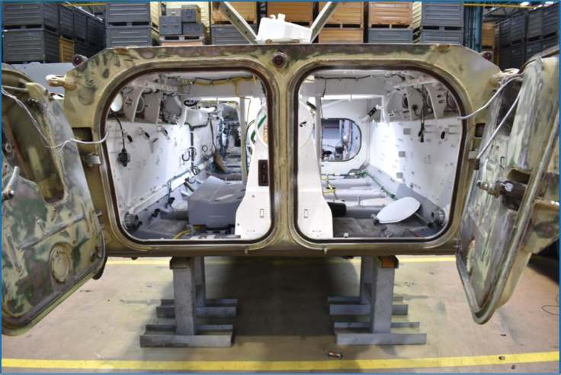
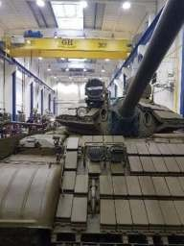
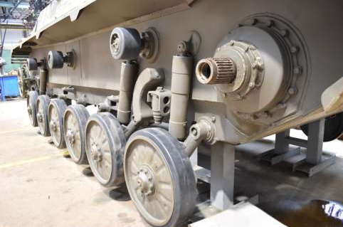

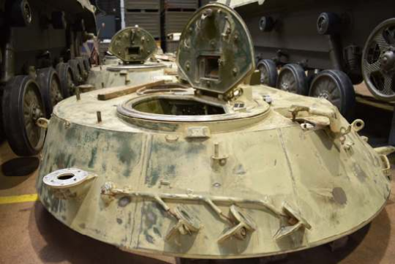
Overhauls and Maintenance of ICV/IFV BMP-II/IIK
Engine Compartment
Crew Compartment
IFV BMP-I/II/IIK
Hull
Disassembly
Turret Prior Overhaul

Slide 12
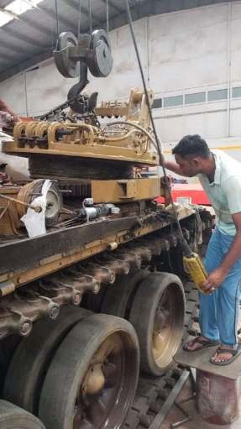
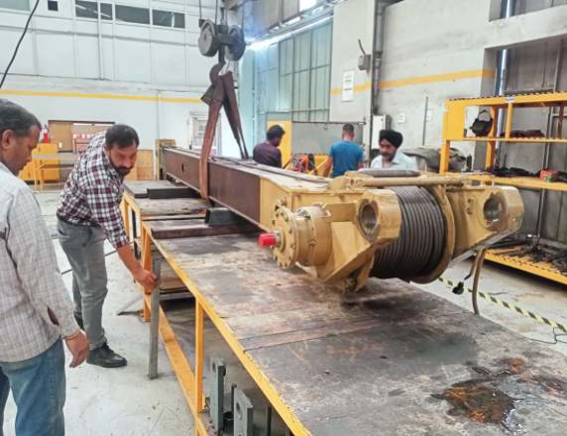
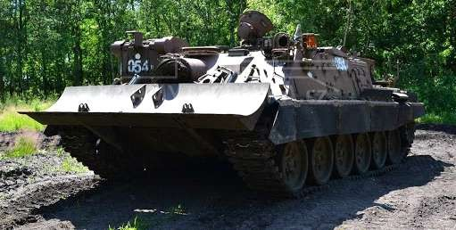

Armoured Recovery Vehicle VT 72 & WZT-3
Customer: Approved supplier of Indian Army
with proven track record
Built on the T-72 chassis for battlefield recovery and repairs
Retains original armor, engine, and WMD resistance
Upgraded utility systems including:
19-ton crane
Winches
Bulldozer
Loading platform
Expertise in design, refurbishment, and modernization of Armored Recovery Vehicles
End-to-end solutions for both tracked and wheeled Armored Recovery Vehicles

Slide 13
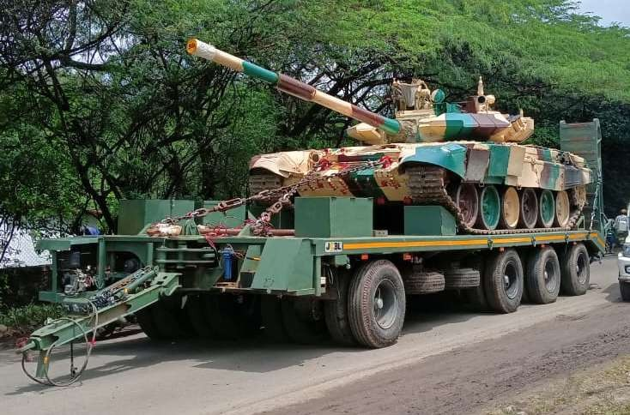
50 Ton Hydraulic Trailer: Advance Tank Transporter
Approved supplier of
Indian Army with proven track record
50 Ton Tank Transporter Trailer with tractor for transporting medium tanks and heavy equipment up to 50 tons
Operates on metalled, un-metalled, and gravel tracks in plains and desert terrains.

Slide 14
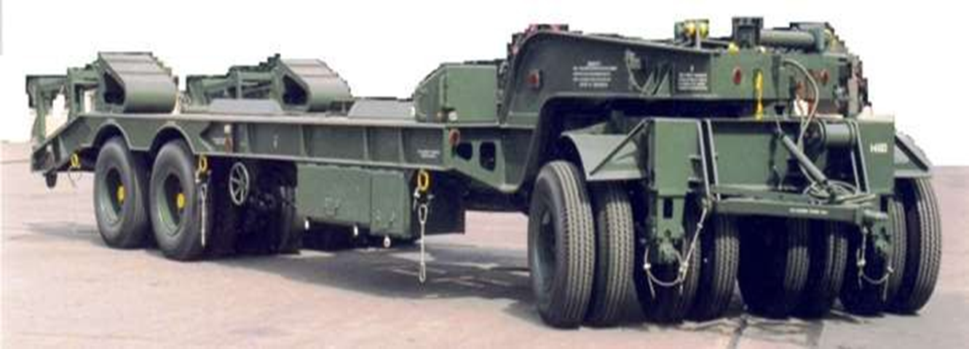
50 Ton Mechanical Trailer: Heavy Duty Tank Transporter
Largest and approved supplier of Indian Army with proven track record
200 Units already supplied. 200 units order in pipeline
12 Twin-wheeled Heavy-Duty Full Trailer Designed for Rough Terrains.
Payload Capacity of 50 Tons.
Used for Transporting Battle Tanks in the Indian Army
Towed by BEML-TATRA T815 VTI 8x8 Vehicle

Slide 15
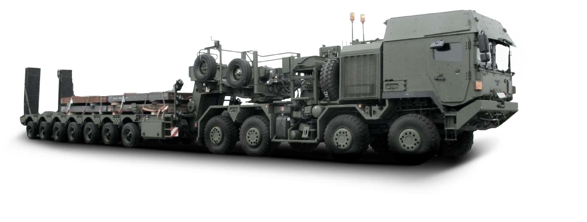
70 Ton Trailer
Designed for rugged terrain, ensuring seamless transportation of medium to heavy equipment
70-ton payload capacity, accommodating tracked vehicles, earth movers, and heavy machinery
Secure lashing arrangements for safe transportation
Built to meet IRC Class 70-R standards for axle, road, and bridge classifications
Selective axle lifting feature for enhanced operational flexibility
Suitable for metaled, un-metaled, and desert tracks

Slide 16
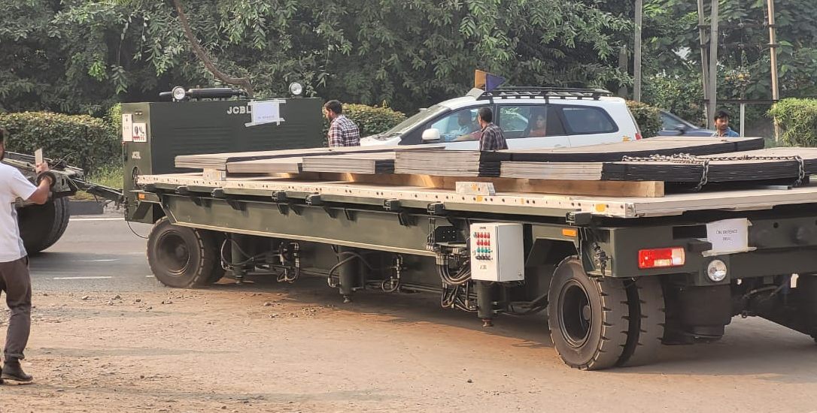
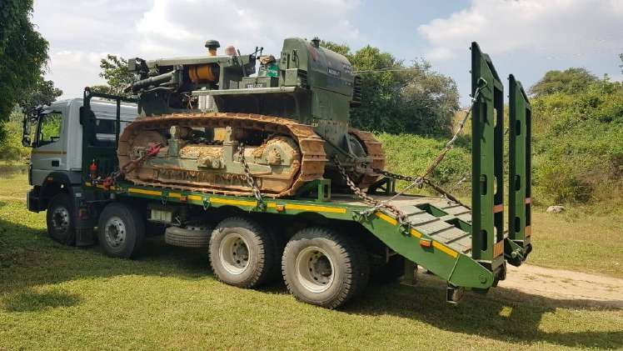
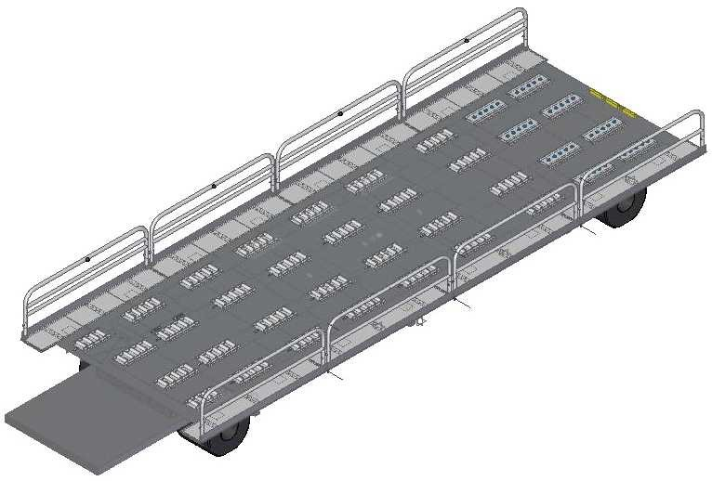
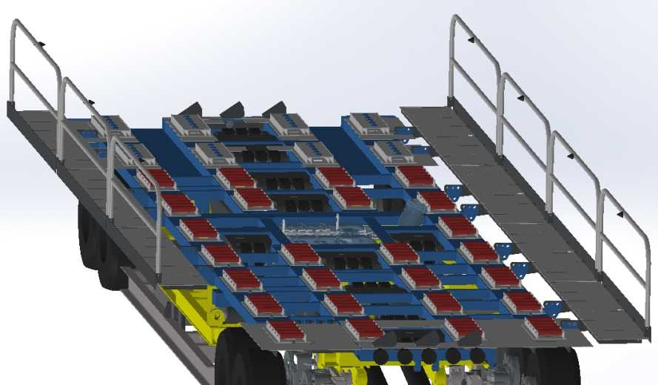
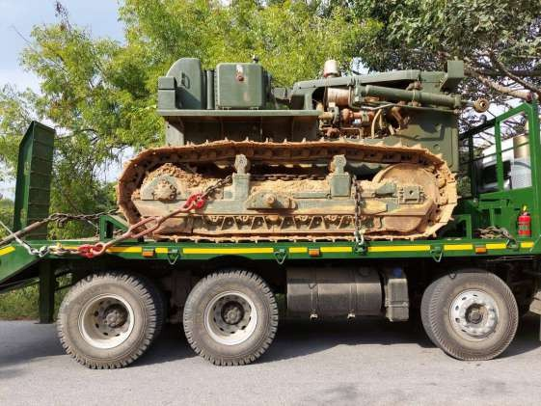
Special Trailers
32 Feet Loader Trailer
Flat Bed Truck (Loading Platform Dozer Weight of 20 Ton)
Part of Airport Ground Support Equipment (AGSE)
Used for loading and unloading air cargo into and from aircraft
32-feet loader trailer designed for military tactical and strategic logistic support
Designed for transportation of Size II Dozers authorized to Engineers Core
Suitable for mountainous roads with a smaller turning radius
Integrated vehicle with a platform capable of carrying payloads of 20 tons or more (excluding bed weight)

Slide 17


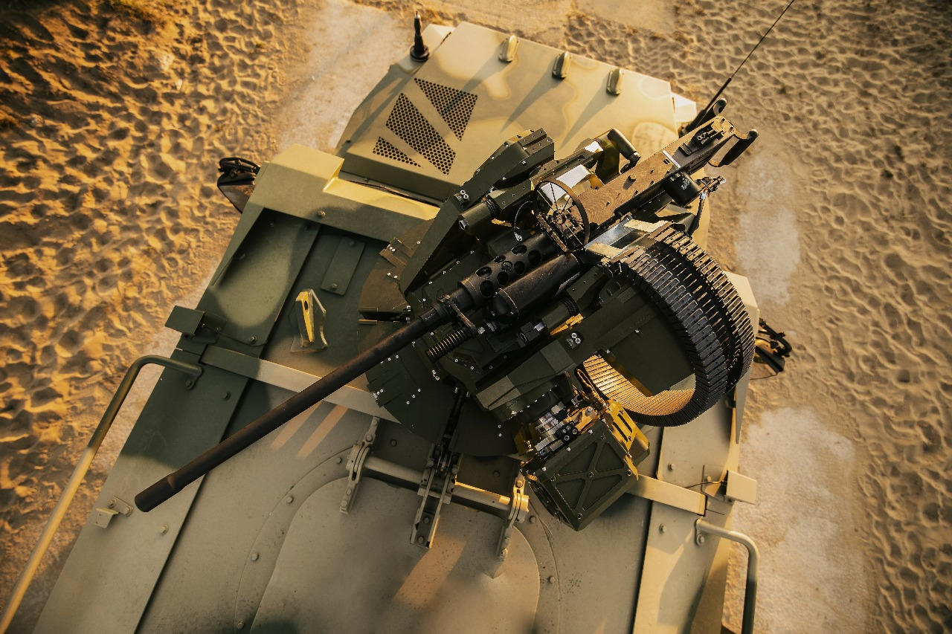
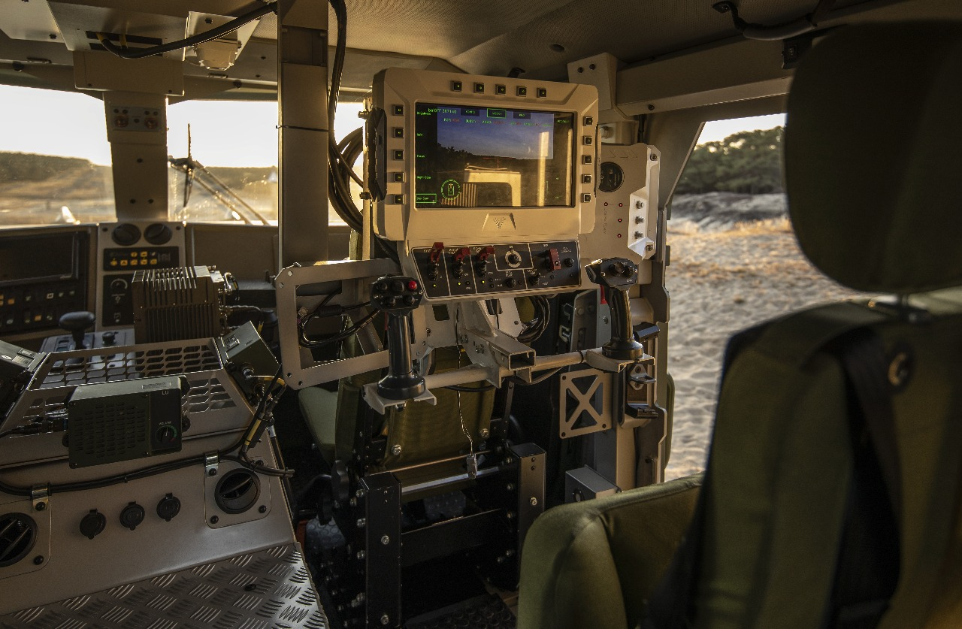
RCWS
(Remote Controlled Weapon System)
CANNA – 50 RCWS (12.7 mm / 7.62 mm / 5.56 mm)
Customer: Ministry of Defence
of Slovak and Czech Republic
Key FEATURES:
In-house Ballistic Computing, Servo Drive & Stabilization Logic (with European partner).
Fully Indigenous Manufacturing in India
Crew Protection: Fully overhead CANNA 50.
High LoF Accuracy: Latest-generation SRCS, optimized for versatile use
LoF & LoS Stabilization: Advanced digital servo and stabilization architecture
Mount Variability: Compatible with calibers of all origins
Modular Ammo Clip: Up to 540 rounds ready for 12.7mm
MIL-STD Compliant with STANAG 4569 Level II ballis tic protection
Safety Firing Zones: Configurable by operator
Transfer of Technology (ToT): Ready for customer facilities
Manual Mode for operational flexibility

Slide 18
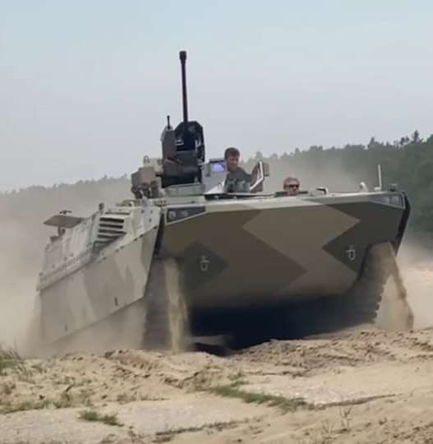
Turret System
30mm Turret
One-Man Turret - 30 mm Capability
Versatile Compatibility: Designed for tracked & wheeled combat vehicles (BMP-1, BTR-70/80, OT-64, etc.)
Future-Ready: Targeting higher calibers & air defense weapon systems
All-weather Operation: Reliable in -30°C to +50°C, day & night, even on the move
360° Traverse & -4° to +50° Elevation for maximum firing flexibility
Modular Design: Welded structure with externally mounted weapons
Advanced Fire Control: Electric weapon control with manual backup
Crew-Centric: Accommodates gunner’s seat, ammo magazines, and control systems
High Effectiveness: Strong ballistic protection, low weight, and modularity
Global Appeal: Optimum choice for armed forces worldwide

Slide 19
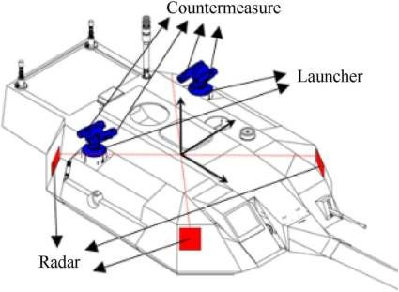
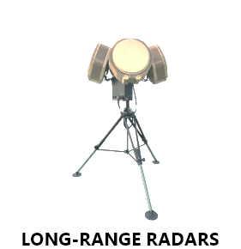
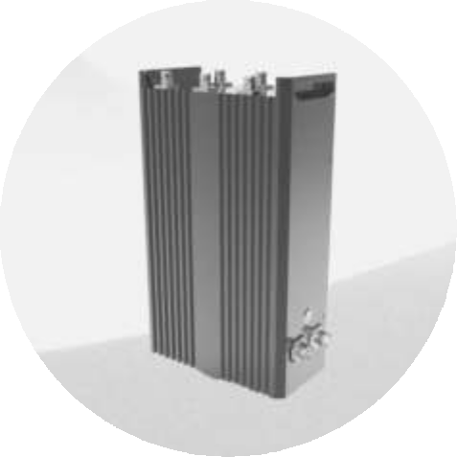
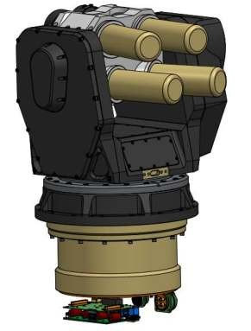
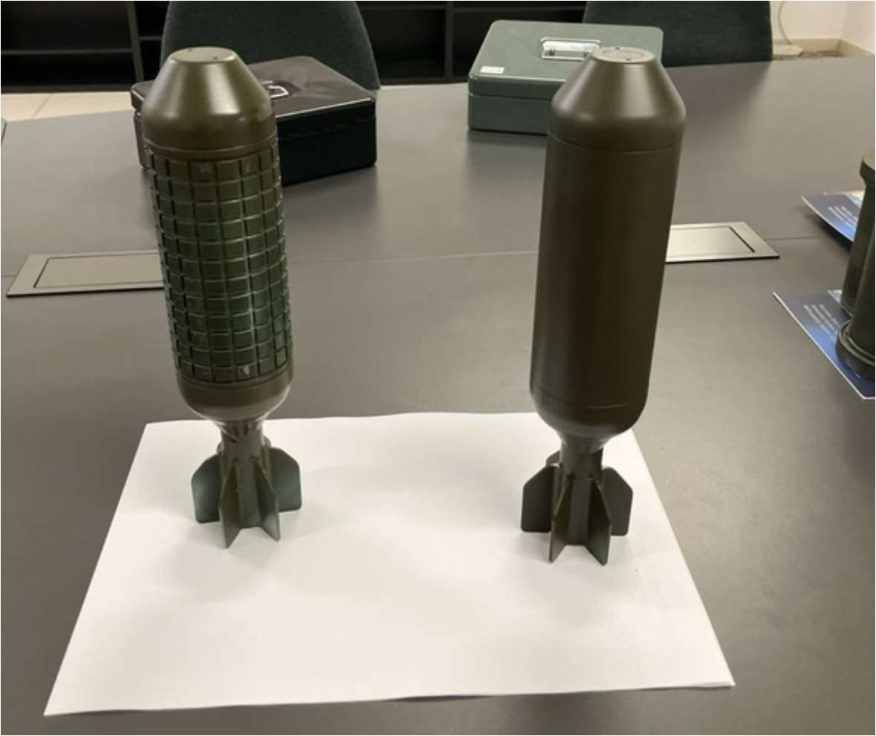
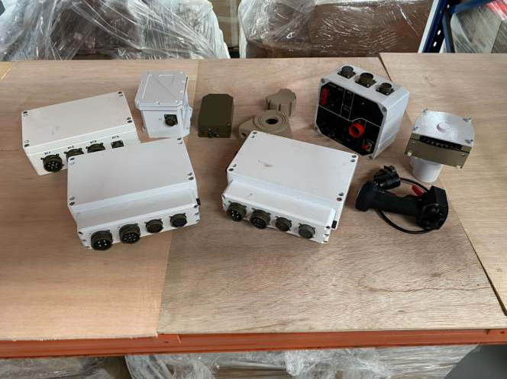
Active Protection System (APS)
APS are advanced defense technologies designed to detect, intercept and neutralize incoming threats such as projectiles, rockets, and anti-tank guided missiles. These systems enhance the survivability of armored vehicles and protect onboard personnel by employing a combination of detection, disruption, and interception techniques.
APS Subsystems:
Radar Subsystem – for threat detection and identification
Jammer Subsystem – for soft kill operations
Countermeasure/Launcher Subsystem – for hard kill operations
Ammunition – for hard kill operations
Fire Control Systems – for ballistic algorithms
Jammer
Launcher
Ammunition
Fire Contrl Sys

Slide 20
ADSL AnTI DRONE SOLUTIONS
Introduction
In response to the evolving threat posed by hostile drones to critical infrastructure and national security, ADSL has developed a cutting-edge, multi-layered Anti-Drone Solutions engineered for rapid detection, precise tracking, and reliable neutralization of unauthorized aerial threats.
This indigenous solution integrates advanced radar technology, RF jamming, electro-optical/infrared (EO/IR) surveillance, interceptor drones, and hard-kill mechanisms—offering a comprehensive protective shield for strategic assets, border area and high-value zones. ADSL offer below mentioned comprehensive range of counter-drone solutions-
Hand Held Counter Drone System (HCDS)
Man-Portable Anti-Drone System (MPADS)
Net-Catcher Anti-Drone System (NCADS)
Vehicle Mounted Anti Drone System (VMADS)
Infra-protection Anti Drone System (IPADS)
6. Border Surveillance and Perimeter Protection

Slide 21
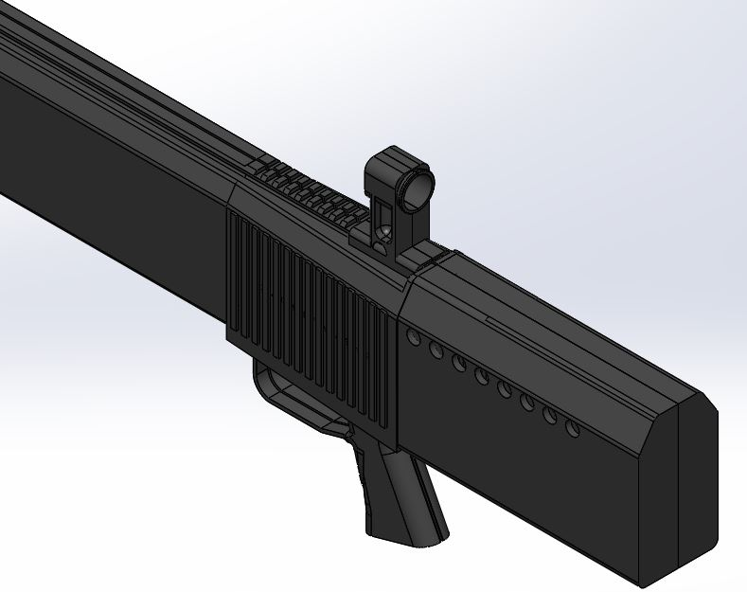
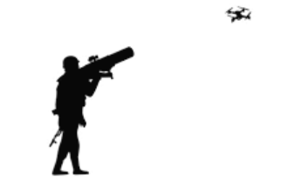
HAND HELD COUNTER DRONE SYSTEM (HCDS)
System Overview
Compact, portable, one man carry system suitable for field operation.
Quick neutralization of unauthorized or hostile drones.
Intercept and disable drones at short to medium ranges without physical destruction.
Effective solution in tactical operations, border area protection, and VIP security.
Key Feature
Multi-Band RF Jamming with frequencies 400 MHz – 2.4 GHz, in six channel..
Quick Deployment and becomes operational within seconds.
Shoulder-fired or rifle-style form factor with trigger operation.
Operational range of detection up to 7 km and Jamming upto 3 km (line of sight).
Updatable threat based library to detect all varieties of drones.
Detect more than 10 drones simultaneously.
Denies GPS/GLONASS/Galileo reception to targeted drones, causing disorientation or auto-landing.
Built-in diagnostic display or LED indicators for system health and battery status
Weight under 6 kg for single-operator use

Slide 22
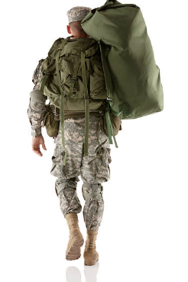
MAN-PORTABLE ANTI-DRONE SYSTEM (MPADS)
The MPADS system is combination of two sub-system-
Backpack-Mounted Drone Detector Unit
Hand-Held Directional Jammer Unit
Key Feature:
Backpack-Mounted Drone Detector Unit
360° RF Detection with signal classification (2.4 GHz, 5.8 GHz, GNSS, custom C2 links)
EO/IR camera (optional) for visual confirmation and passive tracking
Detection range: Up to 7 km depending on terrain and drone size
Detect the drones in less than 10 secs.
Low SWaP (Size, Weight, and Power) with silent operation
Real-time alerts via audio, visual, and vibration feedback on wearable or mobile display
Encrypted communication with jammer unit and central command if needed
Key Feature:
Hand-Held Directional Jammer Unit
Multi-band jamming eg. GNSS, 2.4 GHz, 5.8 GHz, and custom RF bands.
The system support jamming of fwg freq bands 400 MHz to 2.4 GHz simultaneously in 3-6 Channels.
Directional high-gain antenna for precise target disruption
Effective jamming range up to 1.5 - 2 Kms (LoS)
Trigger-based operation with safety interlock and mode selector (disruption / disable)
Battery powered (field swappable) with >1 hours runtime.
Ruggedized for single-person use in combat conditions

Slide 23
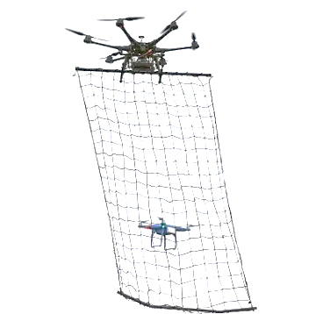
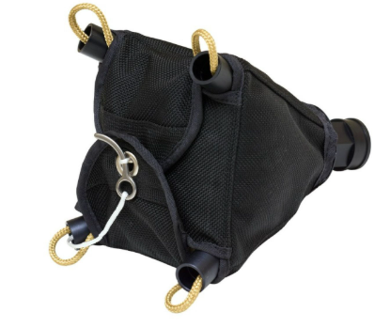
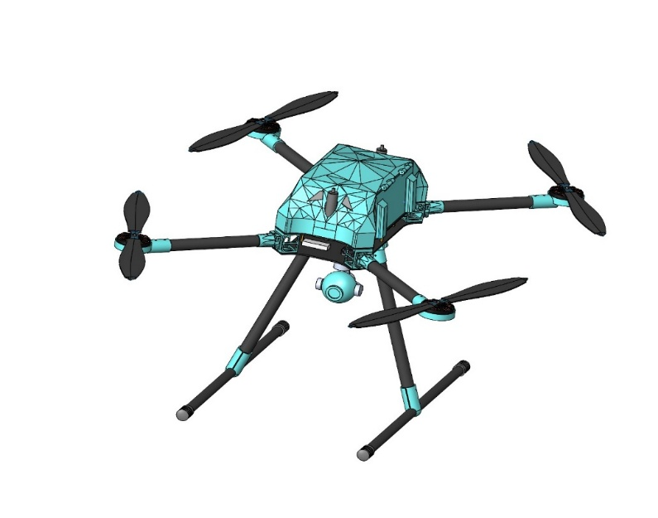
NET-CATCHER ANTI-DRONE SYSTEM (NCADS)
System Overview
An advanced, drone-mounted interception solution designed to capture hostile drones intact using a net-firing mechanism.
Deploying a net to entangle, disable, or tow the target drone to a secure location.
Intercept and disable drones at visual ranges without physical destruction.
Allows the safe recovery of enemy UAVs for forensic investigation, data extraction, or disposal.
Key Feature
Multi-rotor UAV with EO/IR camera for visual target acquisition capacity and net-launcher system.
Communication at 2.4 GHz/5.8 GHz, AES-256 encryption,4-5 km data link
AI-assisted autonomous detection and target tracking.
Drone operational range of up to 2-3 km (line of sight).
Fires net to bring drone down by entangling rotors.
Net Size 3-5 m diameter, Nylon
Effective range: 10–30 meters from target drone.
Capture-and-tow target drone to base.

Slide 24
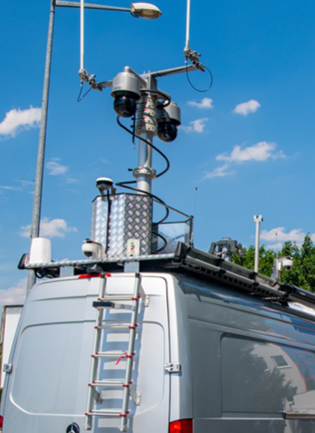
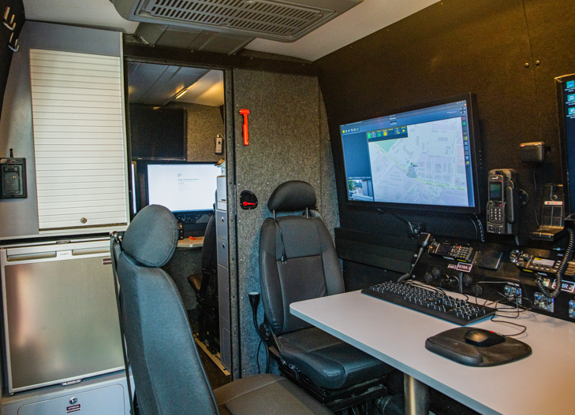
VEHICLE MOUNTED ANTI DRONE SYSTEM
System Overview
Cutting-edge mobile platform designed to detect, track, and neutralize unmanned aerial vehicles (UAVs) and drones.
The systems is integrated with radar, sight system, electronic warfare, and directed energy weapons to provide comprehensive protection against drone threats.
Key Feature
Mobility and Rapid Deployment
Automatic Detection and Classification
Automatic Neutralisation
Capability to neutralise drone swarms
Suitable to quickly deployed at airport, field operation area and civilian populations to protect from potential drone attacks.

Slide 25
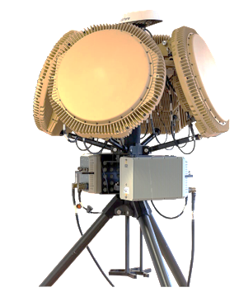
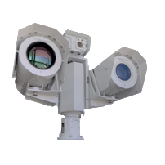
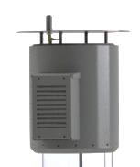

Infrastructure Protection Drone System (IPDS)
Key Feature
3D Surveillance Radar
360° azimuth coverage
Detection range: up to 5–15 km (customizable)
Tracks multiple targets simultaneously
Electro-Optical/Infrared (EO/IR) Sight System
Visual identification and Auto tracking of drone threats.
Day/Night vision capability.
Laser range finder (optional)
RF Detection and Jamming Module
Detects drone communication frequencies (2.4GHz/5.8GHz)
Jams GNSS and RF links to disable drone control
Disrupts drone-to-operator communication
Hard Kill System
Neutralization of hostile drones through kinetic Disrupts
Directed Energy Weapon (Laser)
Net-Gun Launcher or kinetic kill with minimal collateral damage.
Command & Control (C2) Unit
Centralized processing and coordination of threat data and system actions.

Slide 26



Border Surveillance and Perimeter Protection
System Overview
Comprehensive, multi-layered defence solutions designed to secure sensitive installations such as airbases and border posts.
Electric Smart Power Fence- Equipped with vibration detection for initial security layer.
High-Resolution IR and Thermal Cameras- Integrated with inbuilt video analytics for real-time intrusion detection.
Underground Vibration Detection Systems- Use buried optical fiber cables to identify threats, including tunneling activities.
Radars- Integrated with radar and sensor inputs for automated detection and tracking of targets across challenging terrain and weather conditions.
Command Control Centre-Uses AI-driven analytics to filter false alarms and provide live intruder tracking via 3D mapping and Coordinates rapid response actions.
Specialized Surveillance Drones- Provide aerial monitoring and enhance real-time situational awareness.

Slide 27





Platform & Parachute System For Aerial Drop for C130 Cargo Aircraft
Heavy Drop System – 20T
Customer:
Ministry of Defence (INDIA)
Purpose:
Designed for air-dropping equipment up to 20 tons from C130 cargo aircraft.
Key Components:
Aluminium Heavy-Duty Structure (extrusion-based)
Precision Mechanisms (honeycomb, timer mechanism)
Parachute System
Heavy Fabrication, Extrusion, Forging, Machining
Major Sub-Systems:
Platform System:
For palletization and lashing of combat equipment and cargo
Provides mounting for the parachute system
Parachute System:
Extracts and decelerates the platform with payloads during airdrop from aircraft
Nations having C130 Aircraft fleets:
United States, Australia, Canada, India, Italy, United Kingdom, Bahrain, Bangladesh, Denmark, France, Germany, Iraq, Israel, South Korea, Kuwait, Norway, Oman, Qatar, Saudi Arabia, Tunisia, New Zealand, Indonesia, Philippines and Egypt.

Slide 28


Naval Cargo Drop
Naval cargo drop is the aerial delivery of supplies to naval vessels at sea using parachutes or low-altitude techniques, enabling rapid resupply during operations, humanitarian missions, or when docking is not feasible
Customer:
INS KARNA, Ministry of Defence (INDIA)
Challenges:
Precision and Targeting
Weather and Sea Conditions
Parachute System Limitations
Navigation and Communication
Platform Limitations
Key activities:
Platform Repair
New Strap
Made New Tripler Cable
Squib and Platform Cable (Electronics)

Slide 29


Brake Parachute & Military Combat Parachute
Customer:
Ministry of Defence
Brake parachutes also known as drag chutes or drogue parachutes, are small parachutes deployed to rapidly reduce the speed of an object. These are commonly used in aviation, space, and motorsports where conventional braking systems are not sufficient or feasible.
As Development-cum-Production Partner (DCPP), we have received a prototype order for 15 units. Upon successful testing, we will secure the Transfer of Technology (ToT) for future orders.
MCPS (Man-Carrying Parachute System) is a specialized military parachute designed to safely deploy personnel with full combat gear from aircraft. It ensures controlled descent, maneuverability, and safe landing in challenging terrains like forests, water bodies, and high altitudes.
The MCPS enables special forces to deploy with gear using techniques like HAHO, HAMO, and HALO.
It meets international standards, follows PIA testing guidelines
Approved by the Centre for Military Airworthiness

Slide 30


Self Propelled Hydraulic Platform Loader
Customer: Ministry of Defence (INDIA)
Trials By: Indian Air Force
Designed, developed, and supplied to ADRDE, the HPL is used for loading and offloading heavy drop loads from aircraft. It also facilitates transportation of loads from the aerial port to the aircraft tarmac.
HPL is self-propelled for transportation of max. 20000 kg of Cargo-load, with the following speed range:
Unladen forward speed = 32 kmph (max)
Unladen reverse speed = 10 kmph (max)
Loaded platform speed = 15 kmph (max)
Overall Dimensions of HPL:
Length: 10,130 mm
Width (Platform): 2,870 mm
Width (Over Tyres): 2,580 mm
(iv) Height: 2,430 mm

Slide 31


OUR PRESENCE
Connecting aspirations and bringing innovation

Slide 32


























CLIENTS
GOVERNMENT MINISTRIES
DEFENCE AND AEROSPACE (Government Undertakings)
OEMs
STATES & STATE POLICE DEPARTMENT

Slide 33




Our Certifications
Striving for perfection and progress

Slide 34

Our Certifications
Striving for perfection and progress

Slide 35

Thank You.
Jai Hind !

